Slide 1
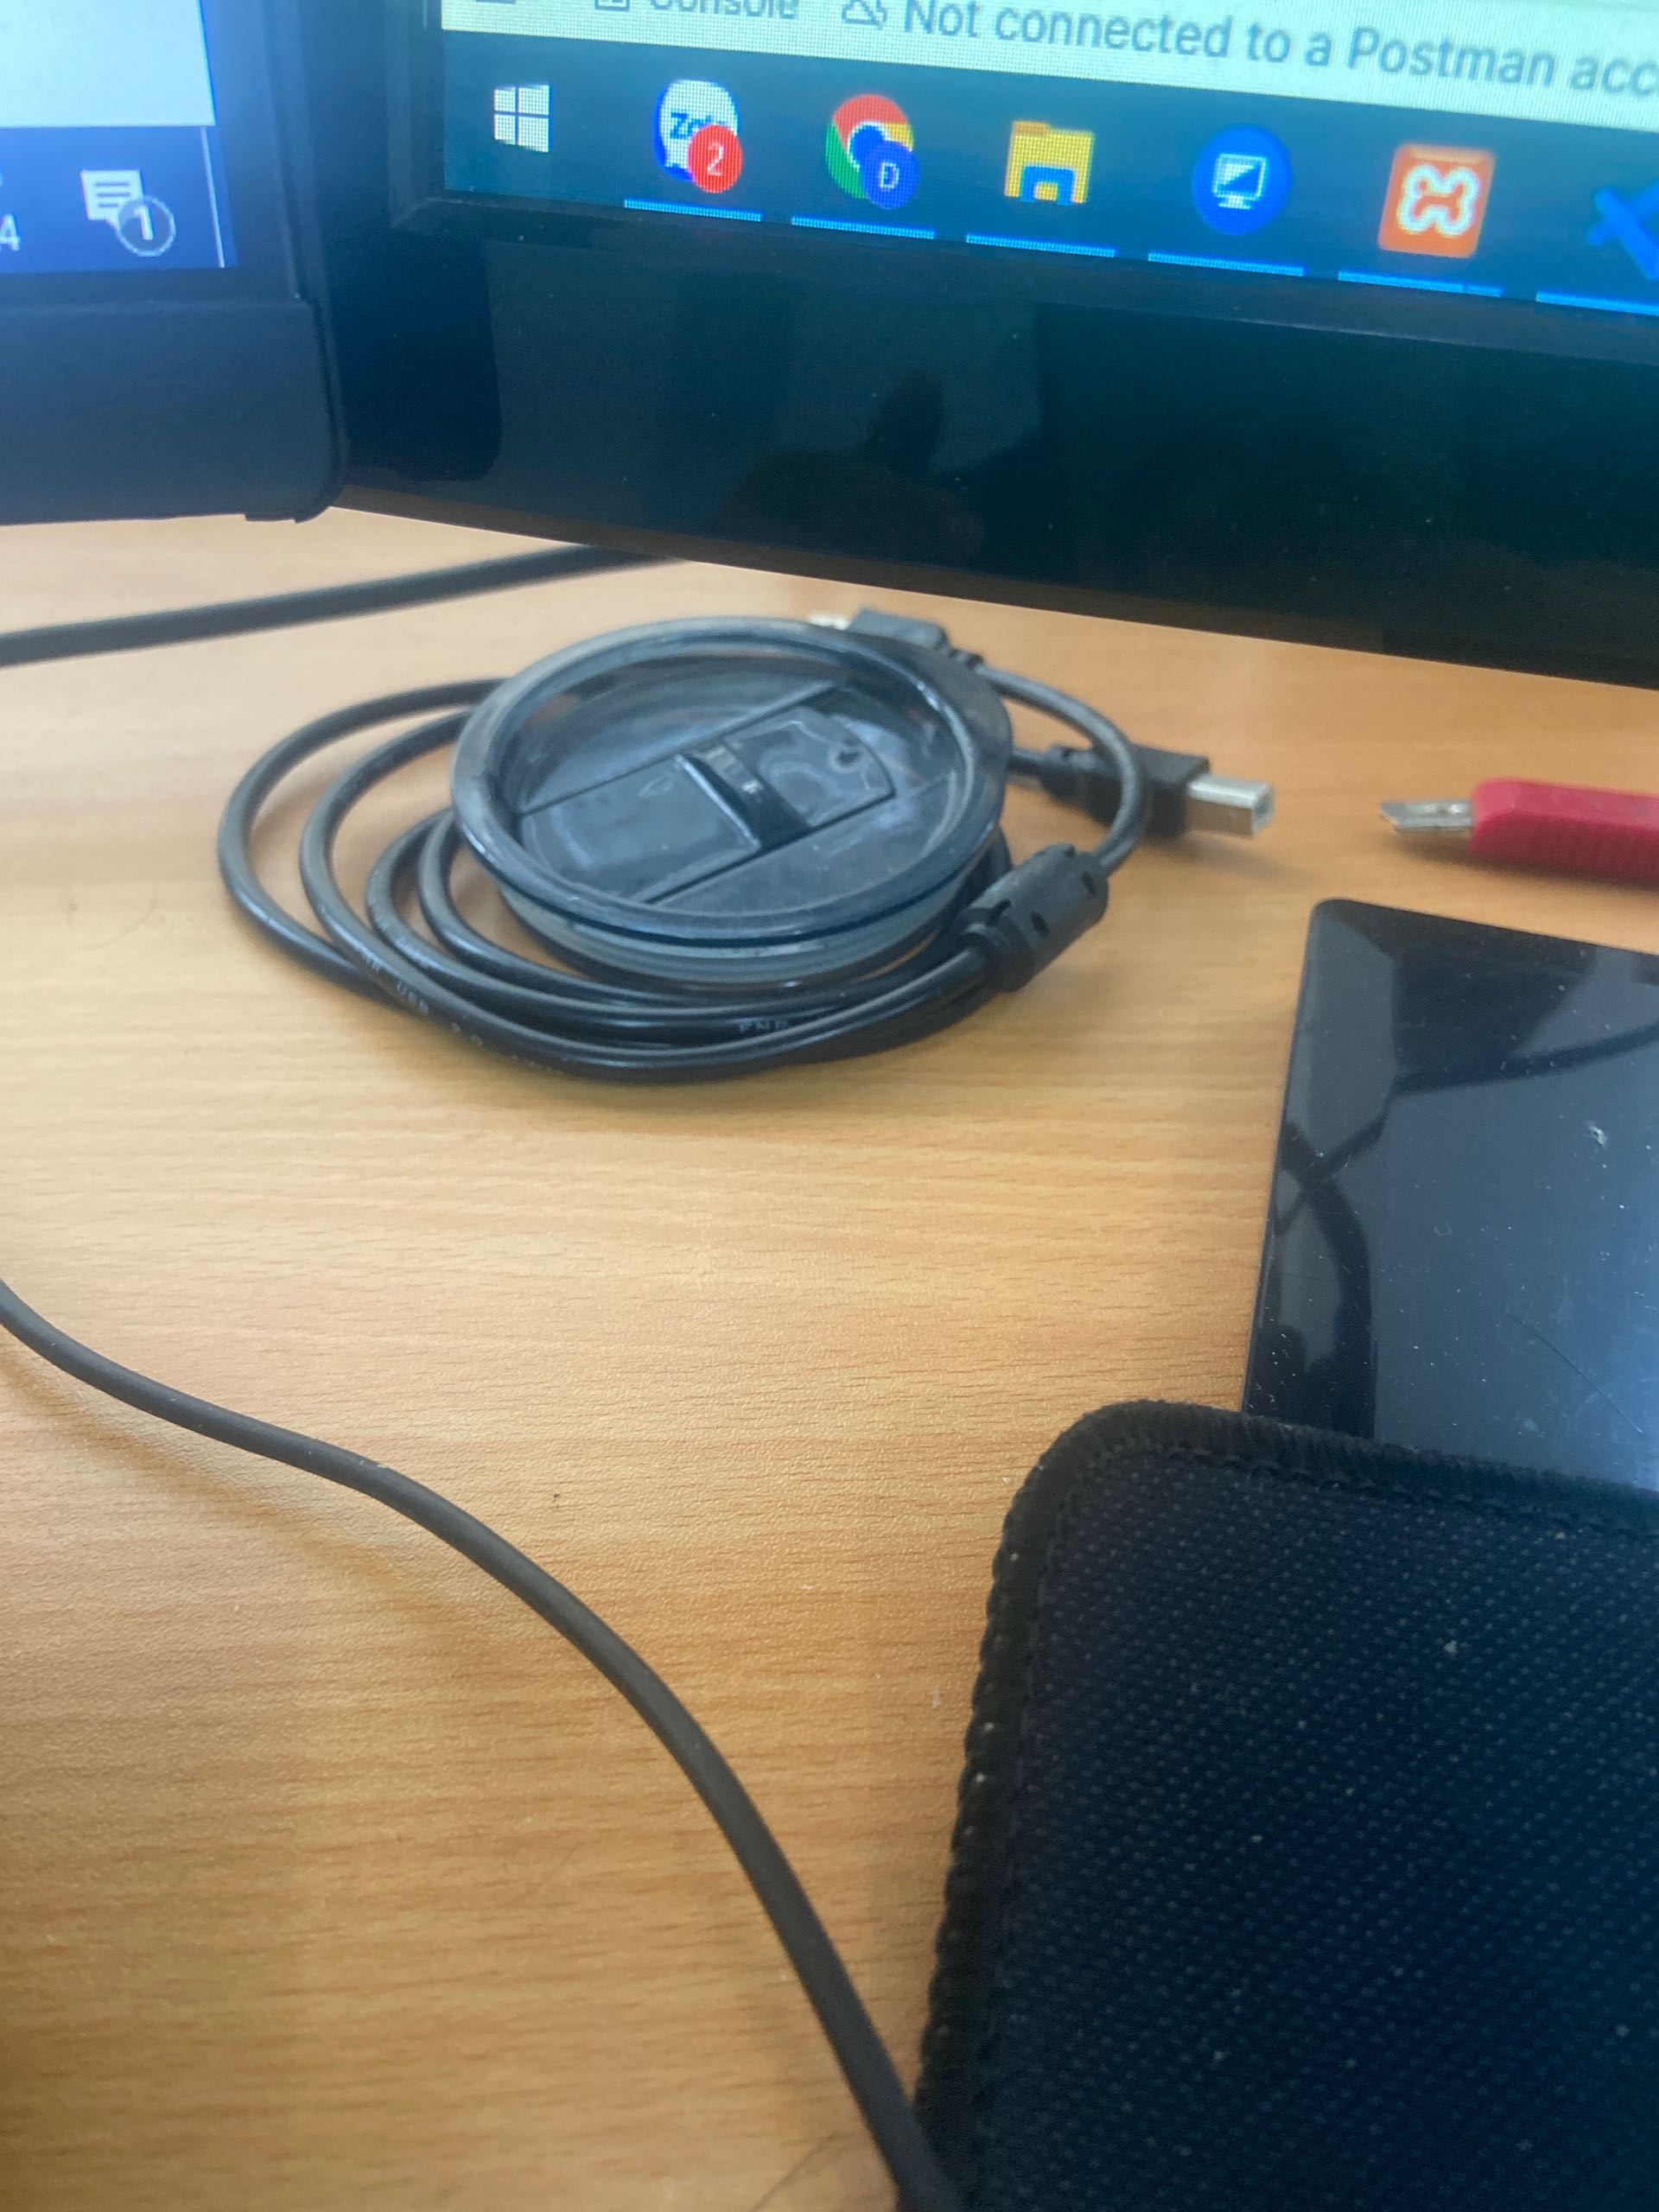
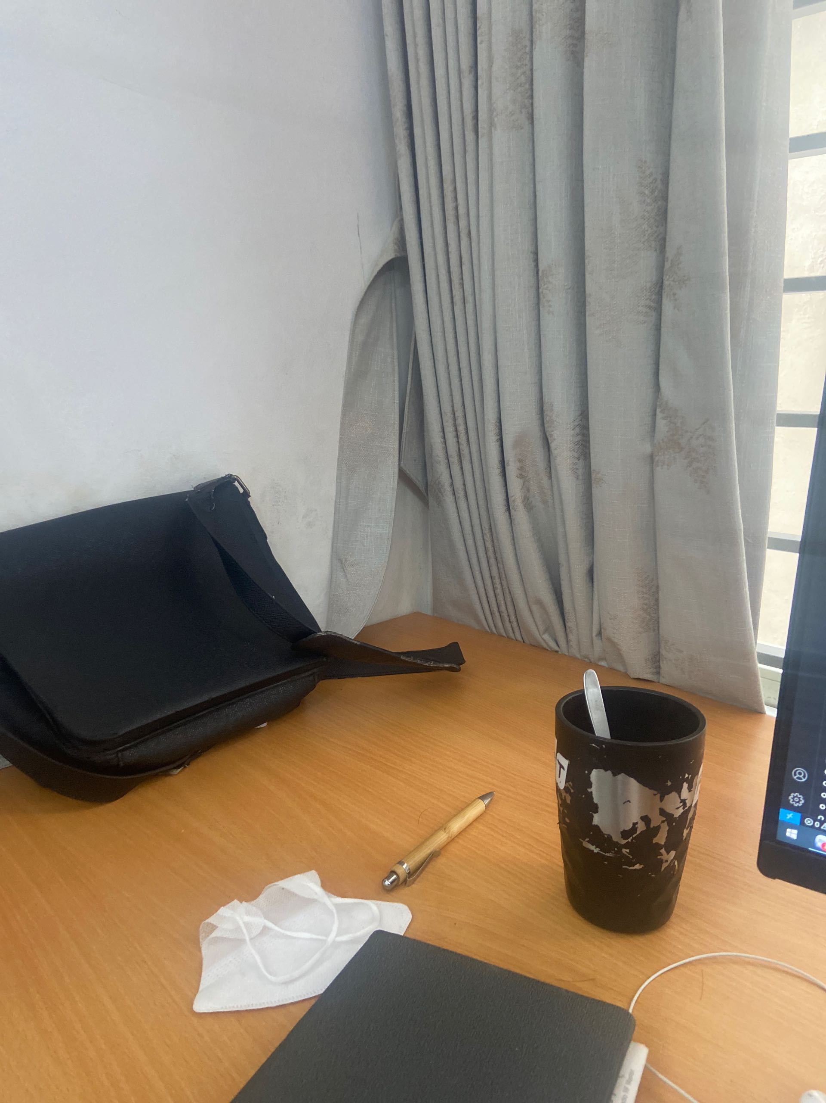
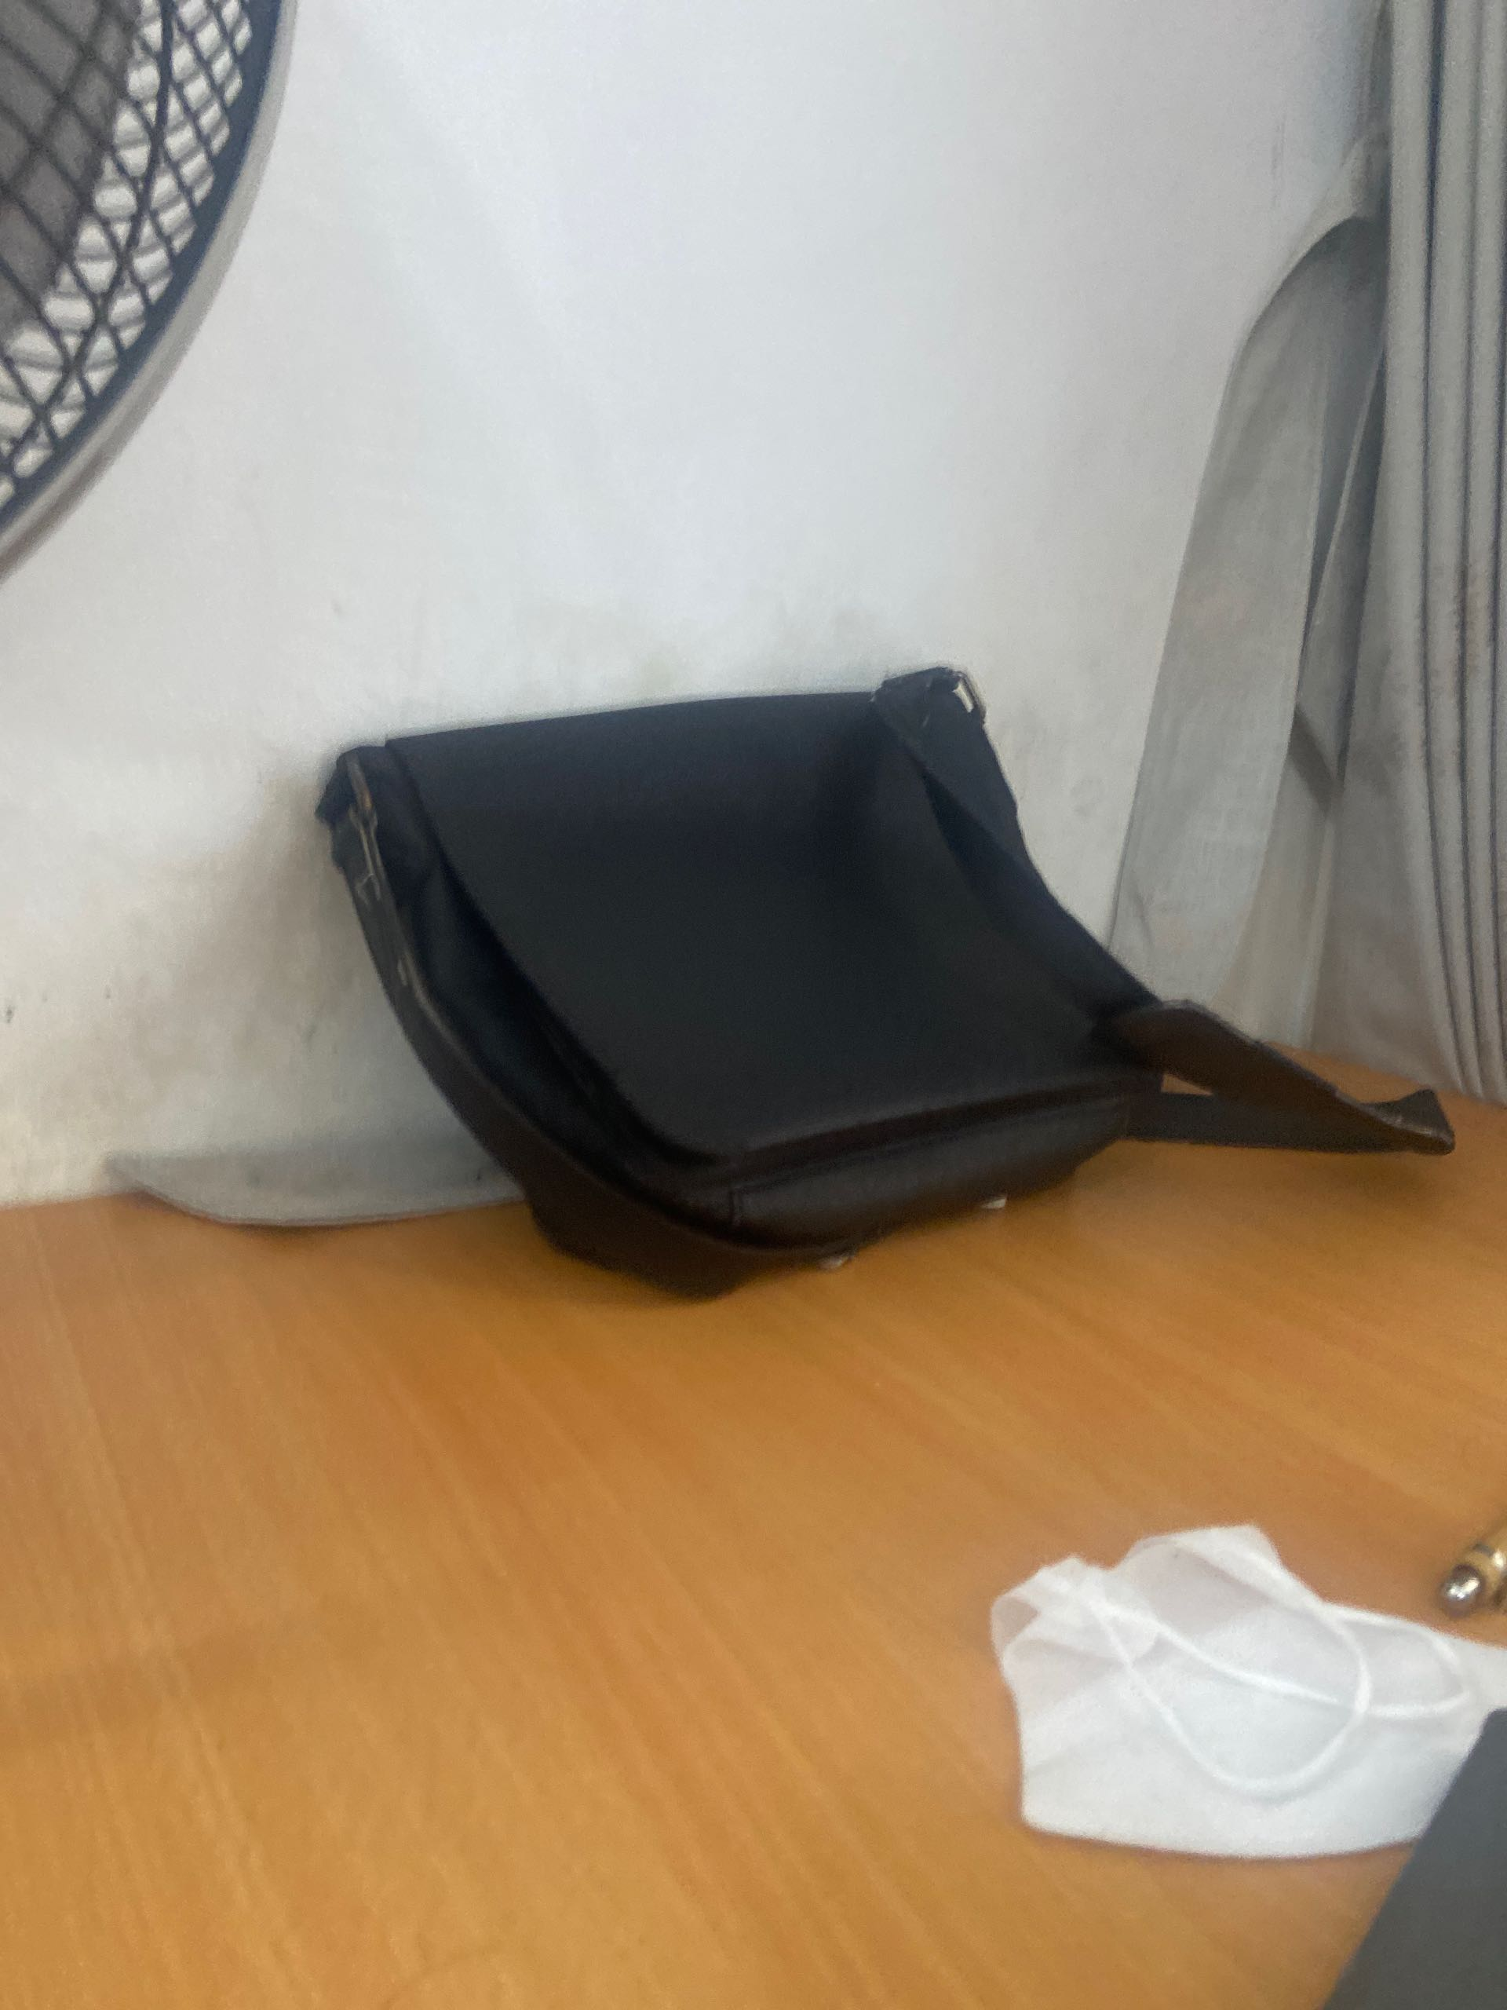
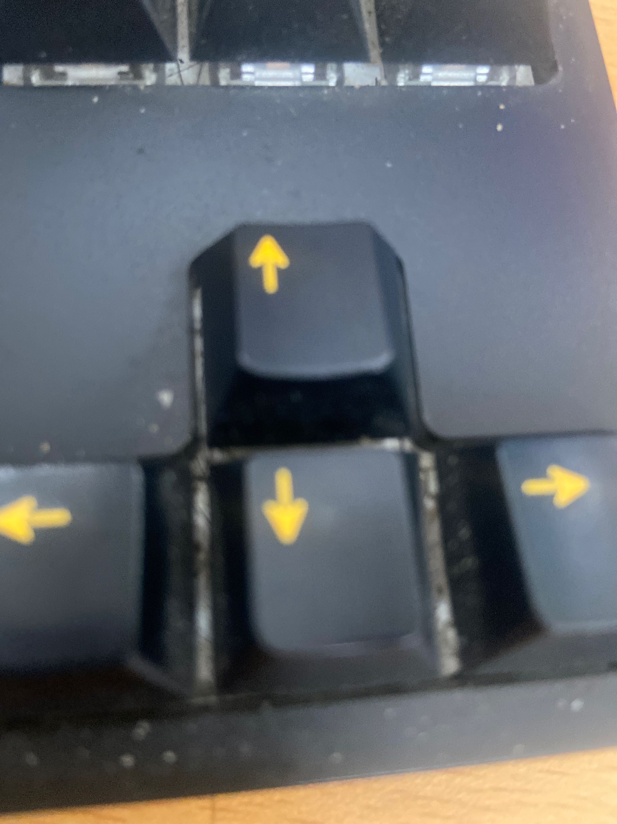
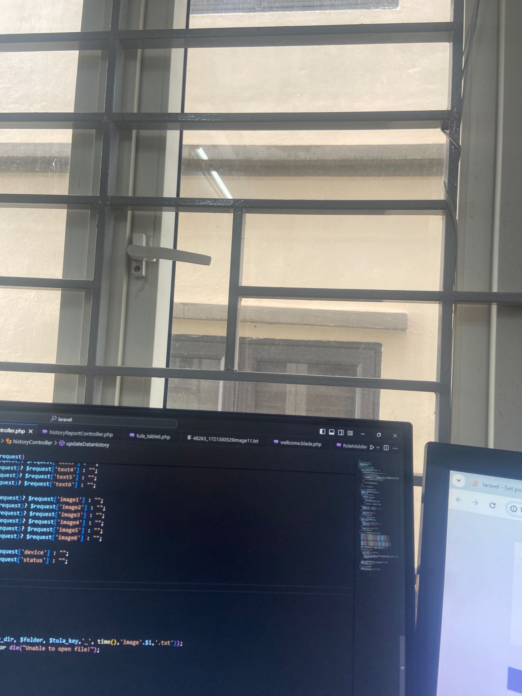
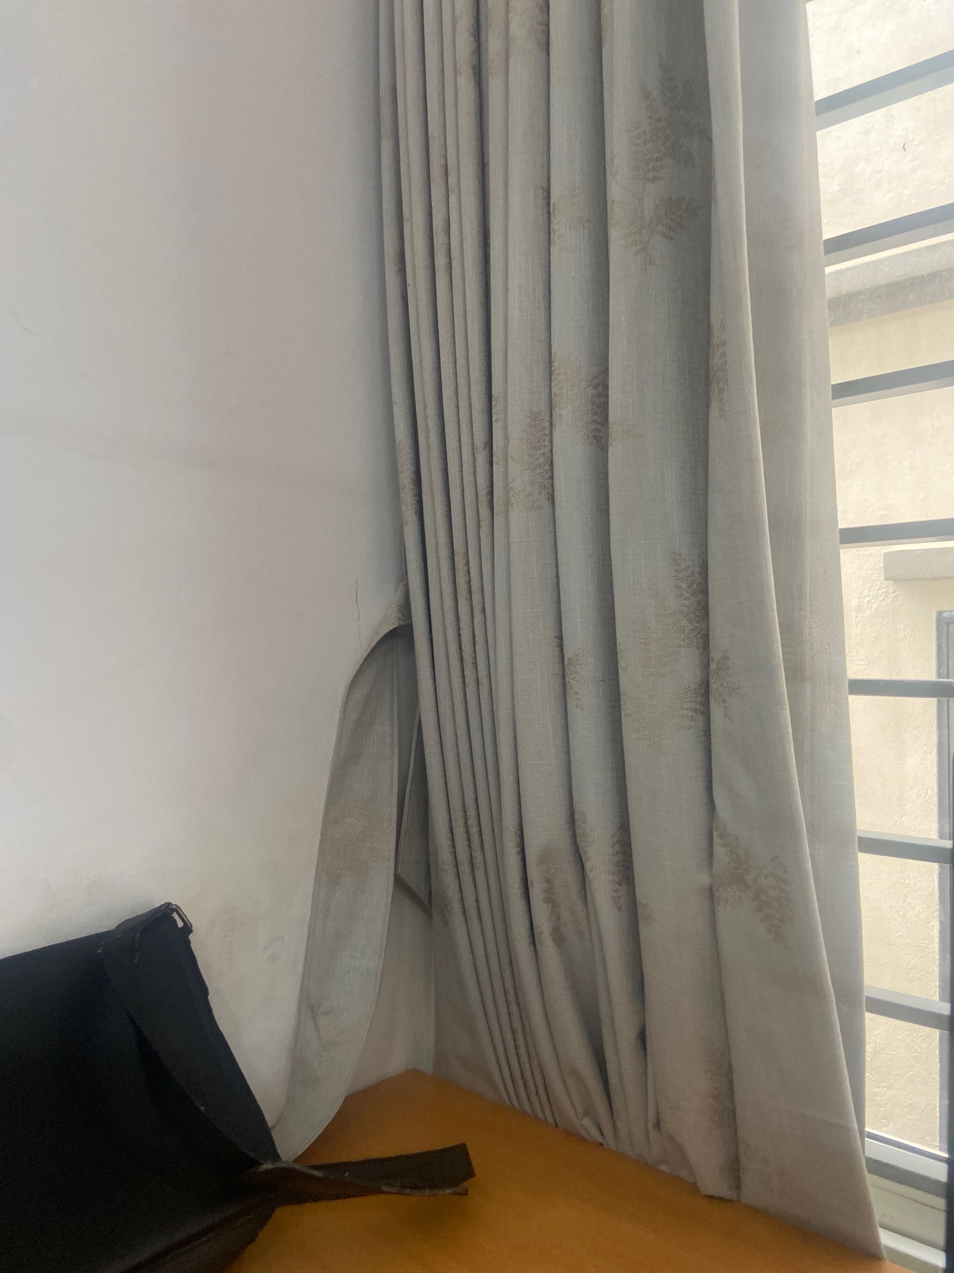
TR20240614_0000
PRINTER BOT 1.2
14.06.2024
1
10h30
2
Lack Of Solvent dđxnjzzn
10h41
1.1-Top
11 Min
lack of solventbsnzj
supply solvent
actione
BEFORE
AFFTER
check solventbzjzj
line running jdjd
check 3nznzn
1/1

